Slide 1

POL 2012: Theories and Models in Political Economy
Energy policy
Espen Moe
Department of Sociology and Political Science
espen.moe@ntnu.no, #9587, 73592230

Slide 2
Why energy policy?
One of the areas where it has become very obvious that there is a lot of tension between different economic approaches
Technology-economics-politics
Energy and politics
Energy and growth
The importance of vested interests
Renewables as the growth engine of the future?
Can renewables grow in a world dominated by petroleum?

Slide 3
New green growth? Or just an endless money-pit?
New wave of economic growth?
Could lead to growth industries
Solar and wind grow fast for several more decades
Cluster of growth industries
Investments at their highest level ever
New Green Growth?
Europe instead subsidizing Chinese growth?!
Industrial growth = economic growth?
Not necessarily
Still based on subsidies → success is expensive!
Crowding out of other jobs?

Slide 4
Solar vs. wind, capacity (MW)

Slide 5
Clean energy investments, billion $, 2004-16

Slide 6
Norway
How to analyze Norwegian energy policy?
Neoclassical analysis (and Keynesian?)
Resource endowments (factor prices)
Cost-effectiveness
Prediction: Petroleum and hydropower and not much else
Schumpeterian and institutional analysis (and Marxist?)
Structural change is difficult
Built institutions around our main energy industries
Vested interests
Discourse of cost-effectiveness that protects the existing structure (rhetorical veil)
Discourse of industrial neutrality
Very hard to shift policy away from status quo
No structural change just because we have access to new technologies

Slide 7
Renewable share of electricity consumption, including hydro

Slide 8
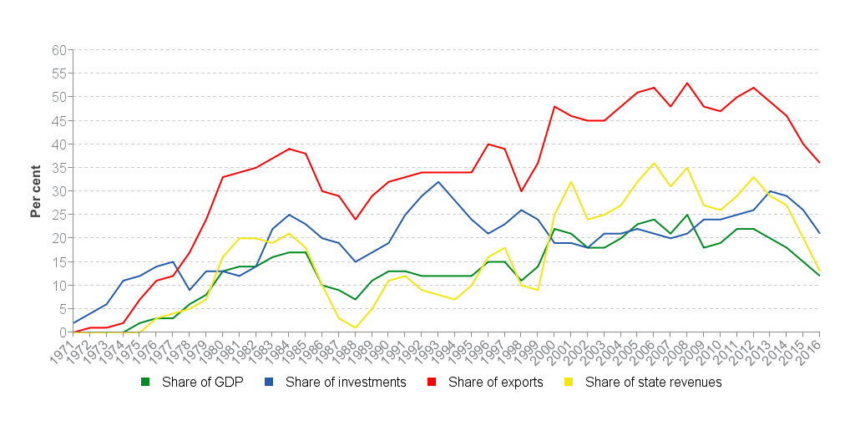
Norway and petroleum

Slide 9
Norway and petroleum vs. wind
No conspiracy against Norwegian renewables, no omnipotent petroleum industry
But a vested interest structure that favors petroleum
(Even if stricter rules than in most countries)
Petroleum political support and institutional channels
Cost effectiveness and technology- + industrial neutrality: Green certificates!
Creates a bias!
Renewables has to fend for itself

Slide 10
Wind power a good idea in Norway?
Depends on the system boundaries…
Norway as the system: Nope.
Regional politics
But we probably already have enough electric power, even if we electrify every single car in the country (and the petroleum sector)
Norwegian default: Little wind power will be built
Europe as the system: Yes/it depends…
Phasing out fossil fuels requires the phasing in of renewables
Norway has the best renewable resources in Europe
Norway as a green battery
Selling electricty to foreign countries
Carbon free energy as future competitive advantage of Norwegian industries?
Norway must be compensated abroad for its electricity exports
Subsea cables abroad

Slide 11
Certificates vs. FITs?
Feed-in tariff (most common)
Guaranteed price on your renewable electricity
Government decides price, market actors decide quantum
Advantage: Predictability, speed
Disadv: Cost, installations not coordinated with grid expansion
Favored by: Engineers and entrepreneurs
Green certificates (Norway + Sweden), tendering/bidding
Guarantees the cheapest renewable electricity
Government decides quantum, market actors bid for quotas, cheapest offer gets the quota → market actors decide the price
Advantage: Cost, efficiency
Disadvantage: Unpredictable, not possible to install faster than the govt wants, underbidding
Favored by: Economists

Slide 12
Why no Norwegian resource curse?
What did we do differently?
Developing countries with petroleum and minerals often remained poor, authoritarian, repressive, underdeveloped
Knowledge accumulation
«Potato chips vs. micro chips»
Institutionalization
Social cohesion, legitimacy, spreading the wealth
Monoindustrialism
Vested interests, rigid economy

Slide 13
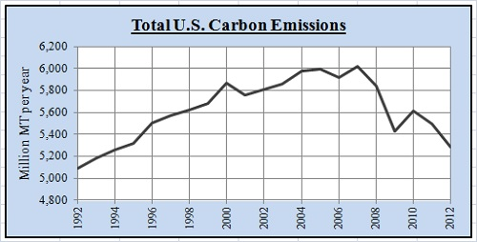
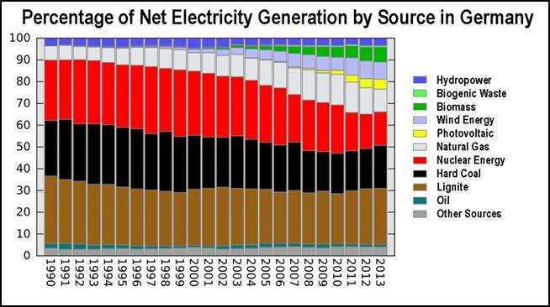
X-factor: Fracking. Consequences?
USA
Germany

Slide 14
Is politics important? US wind power.

Slide 15
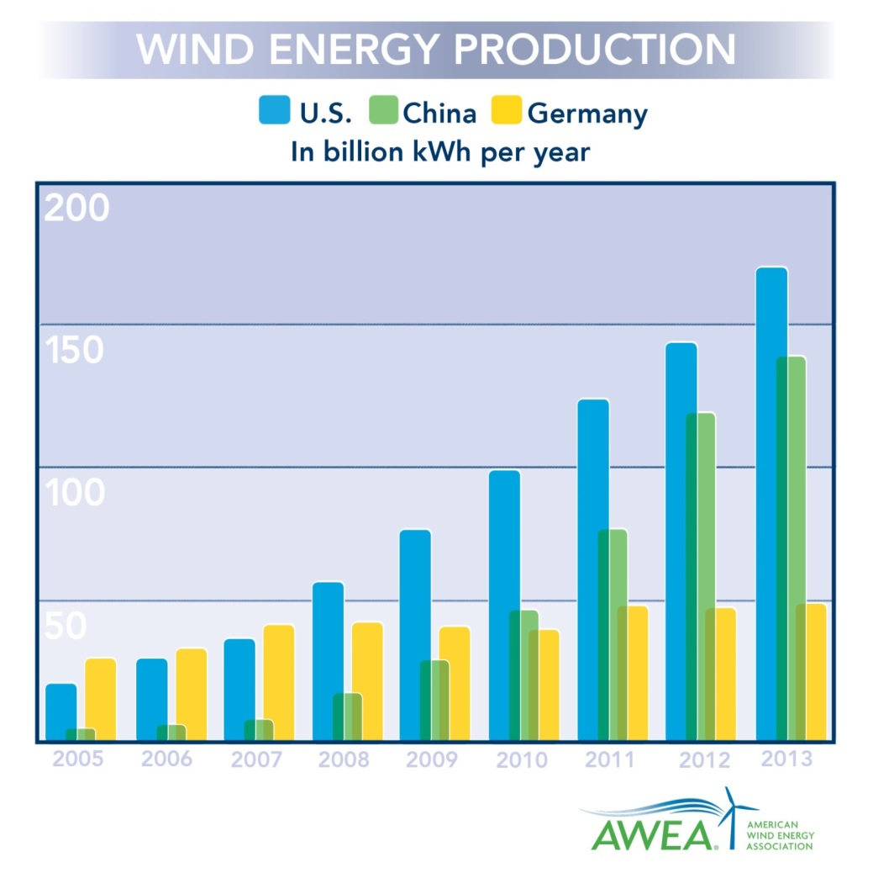
Wind power: Installations vs. generation, China and the US.

Slide 16
China and vested interests?
Can’t argue with success…!(?)
BUT:
No structural change. Driven more by economic growth and energy demand than anything else?
Grid problems. Grid companies reluctant to connect to the grid despite legal obligations. Lots of off-grid capacity.
Industrial structure of SOEs.
Underbidding. Lax budget restrictions.
Energy companies = Thermal, oil and nuclear
Not necessarily very enthusiastic about wind (and solar)
Command and control. Installation over generation.
Institutional structure opaque. Overlapping responsibilities
No Ministry of Energy
Weak control with the provinces. Massive inefficiencies.

Slide 17
Green shift: Will green industry become competitive once we run out of other types of energy?
Investments down 2012-13, up 2014-15, down 2016
Fracking and shale gas (and –oil)
US: gas price down by 80%! Oil price down by 50%++!
Costs (Nothing fails like success…)
Germany, €24b in subsidies (2014)
Subsidizing Chinese solar power? [Europe, Japan]
Electricity grid: Old, fragmented, renewable electricity variable
Europe: upgrades ≈€1 trillion! [by 2020]
US: upgrades ≈$2+ trillion! [by 2035]
Utility companies going bankrupt

Slide 18
What’s the problem?
Price signal should take care of it, right?
YES! In a world without entry barriers, externalities, learning effects, advantages of scale, institutional structures…
So, NO!
Mancur Olson
Vested interests, rigidities, sclerosis
Economically important industries becoming politically influential
There’s no such thing as industrial neutrality [næringsnøytralitet]. Institutional structure always favors the existing actors.

Slide 19
Market mechanisms will solve the problem?
Industrial neutrality and cost effectiveness
The green shift happens once renewable energy becomes competitive?
Market mechanisms → phasing in of REN, but no system change
Carbon taxes: So high that politically impossible before system change
ETS: Carbon quota markets need a strong regulator (otherwise carbon prices zero…)
Energy efficiency is cool, but does not lead to system change
(Only a new energy system does)
Preference for end-of-pipe and low-hanging fruits
Market mechanisms rarely build infrastructure
The problem is structural: If we want system change, tinkering and incremental change is not enough. Politically very difficult!

Slide 20
Energy efficiency
Typically the most cost-effective
Often by a huge margin
The neoclassical (and technological) solution
Incremental change
Politically easy to implement
May even lead to bigger exports (everyone wins!)
Does it get us all the way?
Rebound effect
Does it lead to system change?
Incentives for behavioral change?
Just reducing the stress on the existing system?
Reduces our electricity consumption
(How is electricity generated?)
Making it easier to continue doing exactly what we are already doing?

Slide 21
Technological shifts
Don’t just happen!
Old industrial actors makes growth hard for new actors
Wind power will not replace oil just because it is comptetitive…!
(It helps being competitive, but…)
…structures that preserve the petroleum paradigm

Slide 22
Markets and state
The easy part of the green shift
FITs or green certificates
State: Framework conditions (costs money).
Industrial actors in the market place: Do the actual work.
Renewable energy in addition to fossil fuels
Result: Rapid phase-in of renewable energy – up to a certain level
What remains: The difficult part…!
Renewable energy instead of fossil fuels
Upgrading gridlines
But utility companies are going bankrupt everywhere…!
Cross-country connections
Energy policy from national to supranational
Europe-wide markets
MUCH MORE POLITICS, much more coordination, much more interest battles, much more negotiating and bargaining, much more active state required

